Slide 1

Unsupervised Learning applied to THE Customer Lifetime Value (CLV)
September 21th, 2021 Claudio Giorgio Giancaterino

Slide 2

Roadmap:
Customer Lifetime Value
Exploratory Data Analysis
Customer Lifetime Value Modelling
Unsupervised Learning
Dimensionality Reduction
CLV Prediction with reduced features space
CLV Prediction with augmented features space
Clustering
CLV Prediction with augmented features space
Clustering as Portfolio Analysis
Github repository: https://github.com/claudio1975/Customer_Lifetime_Value

Slide 3
Customer Lifetime Value

Slide 4
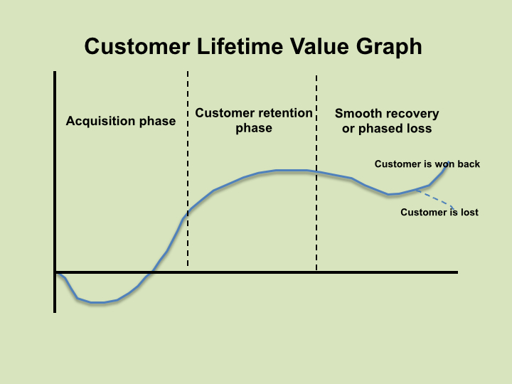
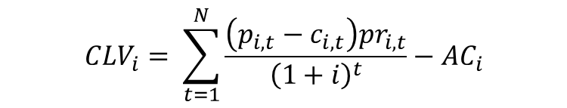
SPREAD PREDICTIVE ANALYTICS TOWARDS INSURANCE MARKETING FIELD
A key tool: Customer Lifetime Value.
It’s the value of a customer for a Company over the span of their lifetime relationship.
$${CLV}_{i}= \sum_{t=1}^{N}{\frac{\left(p_{i,t}−c_{i,t}\right){pr}_{i,t}}{{\left(1+i\right)}^{t}}−{AC}_{i}}$$

Slide 5
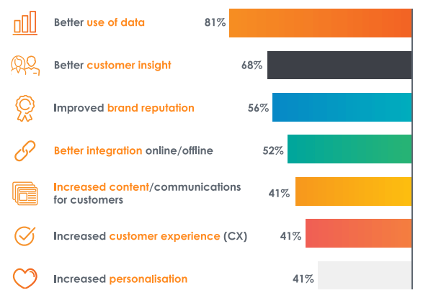
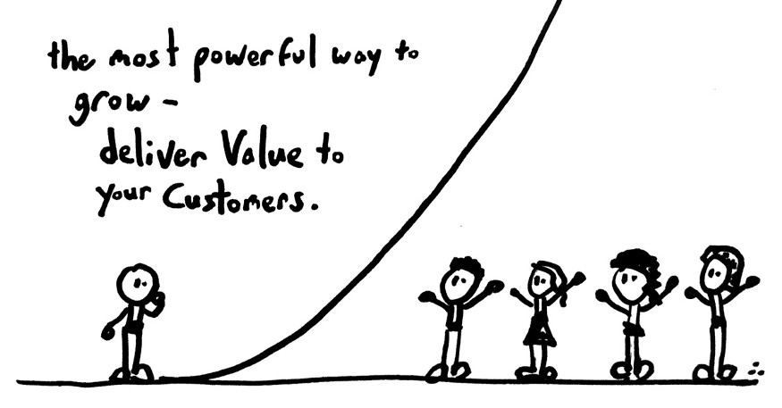
What increases CLV in business, according to a survey by Criteo (source)

Slide 6
Data

Slide 7
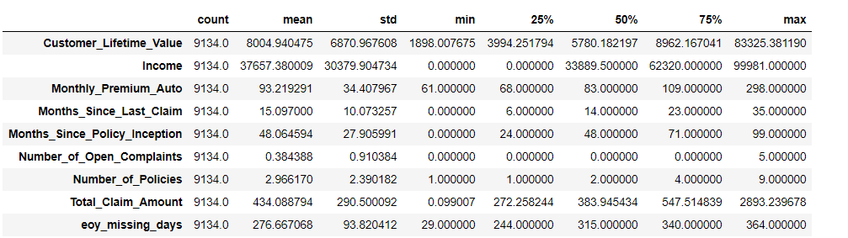
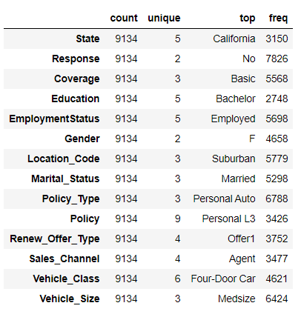
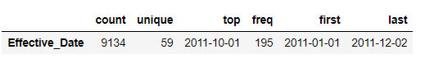
USE CASE: AUTOINSURANCE DATA SET
Data: https://www.ibm.com/communities/analytics/watson-analytics-blog/marketing-customer-value-analysis/; https://www.kaggle.com/pankajjsh06/ibm-watson-marketing-customer-value-data

Slide 8
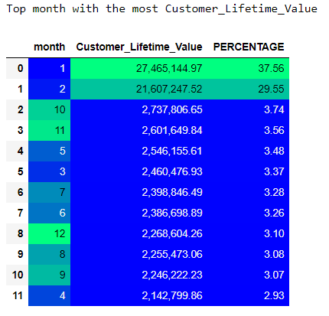
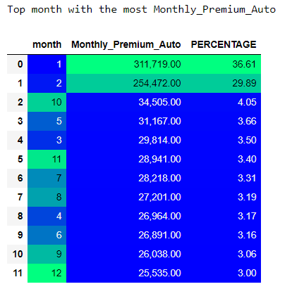
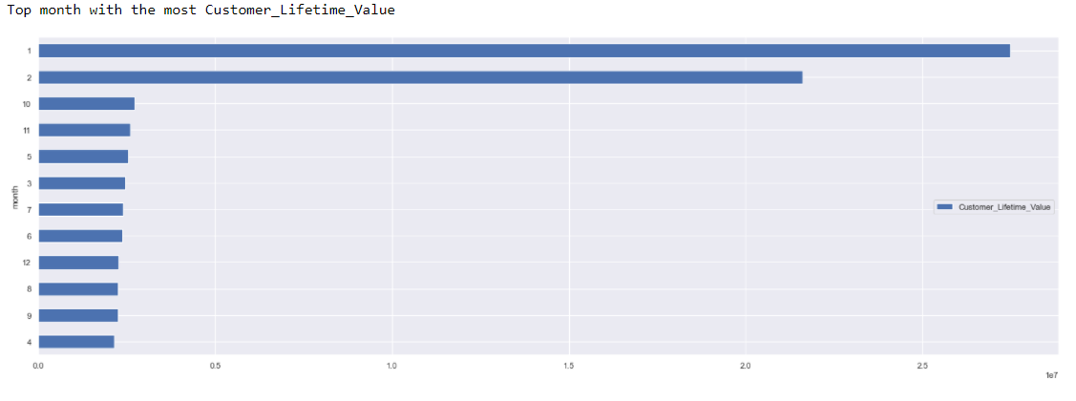
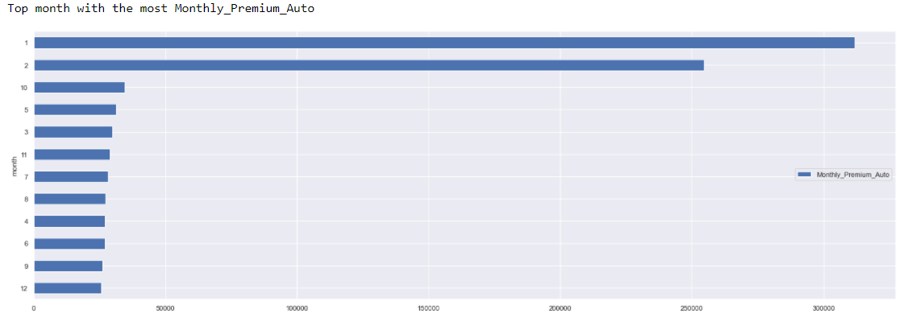
Distribution of CLV and Monthly Premium Auto in the year

Slide 9
Customer Lifetime Value Modelling

Slide 10
Which model can I use to predict CLV?
Generalized Linear Model (GLM)
Random Forest (RF)
Gradient Boosting Machine (GBM)
Neural Networks (NN)

Slide 11
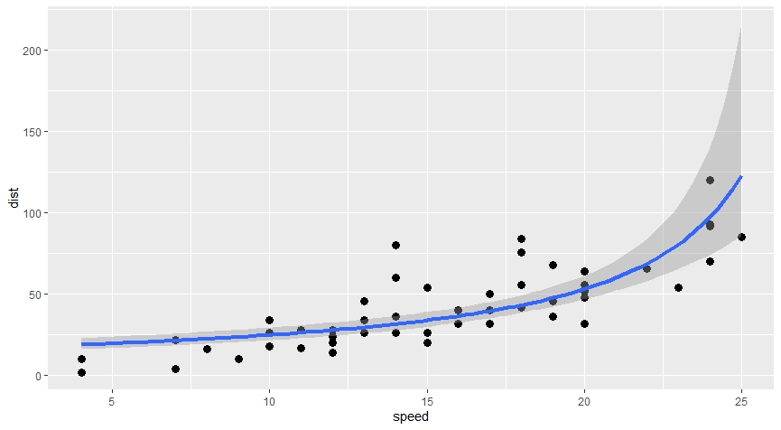
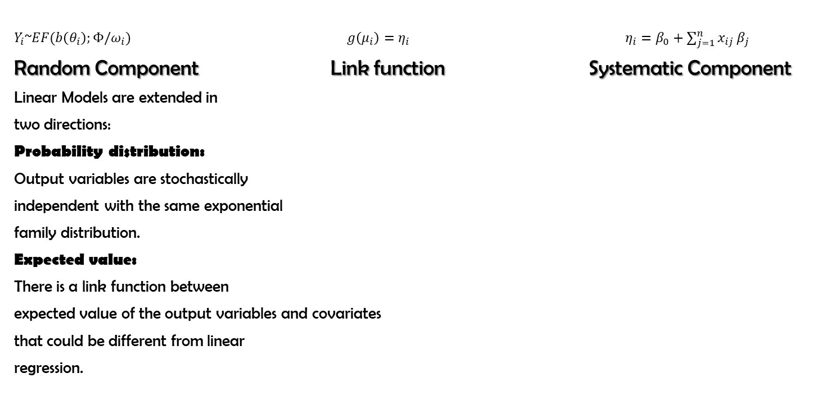
Generalized Linear Model (GLM)
$Y_{i}$~$EF(b\left(θ_{i}\right);{Φ/ω}_{i})$ $g\left(μ_{i}\right)=η_{i}$ $η_{i}=β_{0}+\sum_{j=1}^{n}{x_{ij}}β_{j}$
Random Component Link function Systematic Component
Linear Models are extended in
two directions:
Probability distribution:
Output variables are stochastically
independent with the same exponential
family distribution.
Expected value:
There is a link function between
expected value of the output variables and covariates
that could be different from linear
regression.

Slide 12
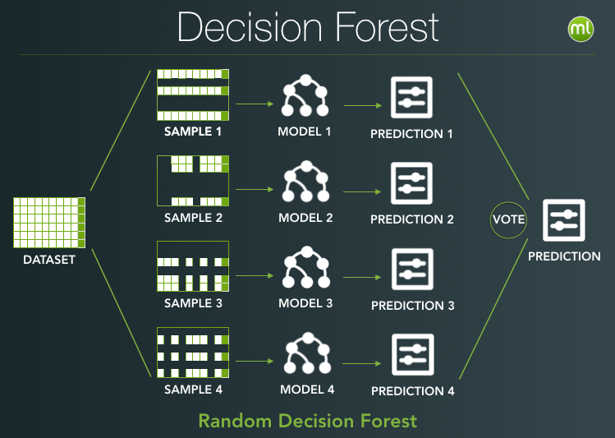
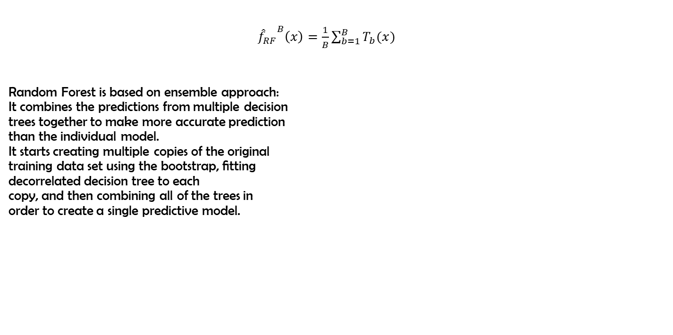
Random Forest (RF)
${{\hat{f}}_{RF}}^{B}\left(x\right)=\frac{1}{B}\sum_{b=1}^{B}{T_{b}(x)}$
Random Forest is based on ensemble approach:
It combines the predictions from multiple decision
trees together to make more accurate prediction
than the individual model.
It starts creating multiple copies of the original
training data set using the bootstrap, ﬁtting
decorrelated decision tree to each
copy, and then combining all of the trees in
order to create a single predictive model.

Slide 13
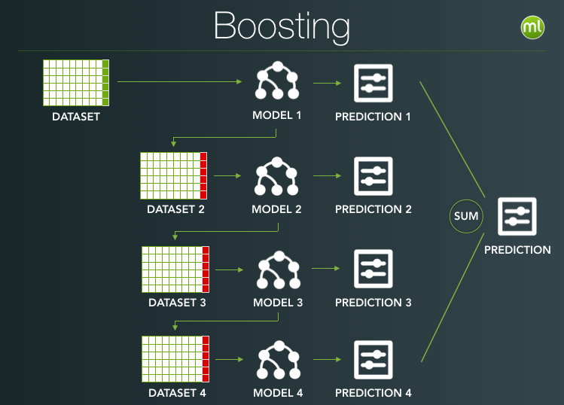
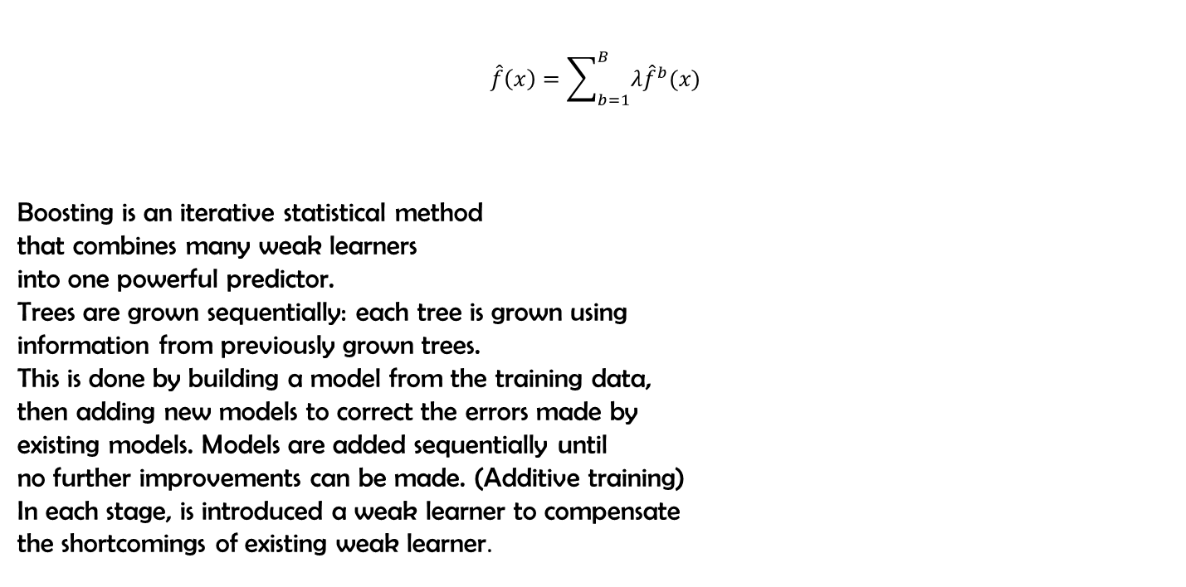
Gradient Boosting Machine (GBM)
$$\hat{f}\left(x\right)=\sum_{b=1}^{B}{λ{\hat{f}}^{b}(x)}$$
Boosting is an iterative statistical method
that combines many weak learners
into one powerful predictor.
Trees are grown sequentially: each tree is grown using
information from previously grown trees.
This is done by building a model from the training data,
then adding new models to correct the errors made by
existing models. Models are added sequentially until
no further improvements can be made. (Additive training)
In each stage, is introduced a weak learner to compensate
the shortcomings of existing weak learner.

Slide 14


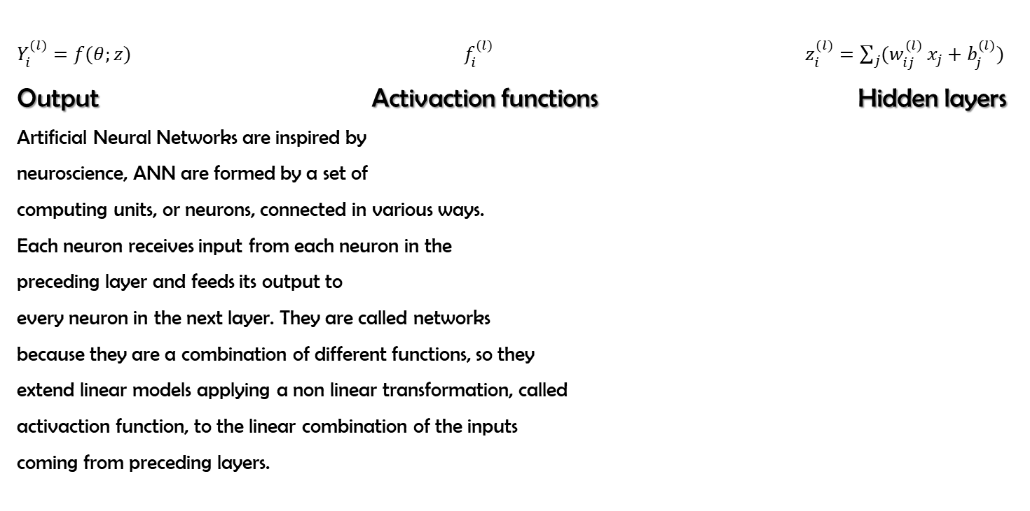
Artificial Neural Network (ANN)
$Y_{i}^{(l)}=f(θ;z)$ $f_{i}^{(l)}$ $z_{i}^{(l)}=\sum_{j}{(w_{ij}^{(l)}}x_{j}+b_{j}^{(l)})$
Output Activaction functions Hidden layers
Artificial Neural Networks are inspired by
neuroscience, ANN are formed by a set of
computing units, or neurons, connected in various ways.
Each neuron receives input from each neuron in the
preceding layer and feeds its output to
every neuron in the next layer. They are called networks
because they are a combination of different functions, so they
extend linear models applying a non linear transformation, called
activaction function, to the linear combination of the inputs
coming from preceding layers.

Slide 15
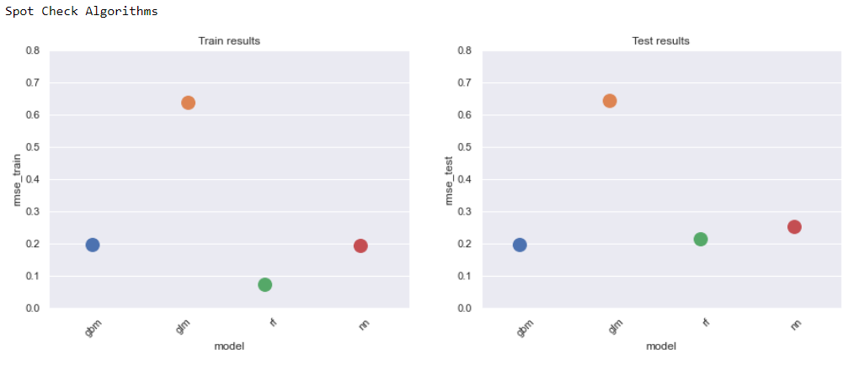
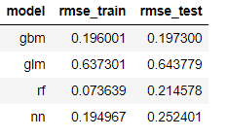
Results
....and the winner is…..GBM!!! It is used as baseline model for next experiments!!!

Slide 16
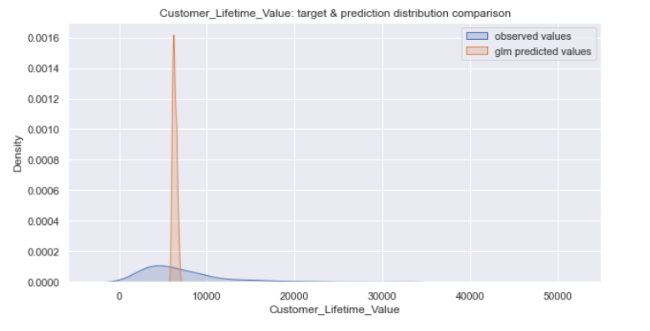
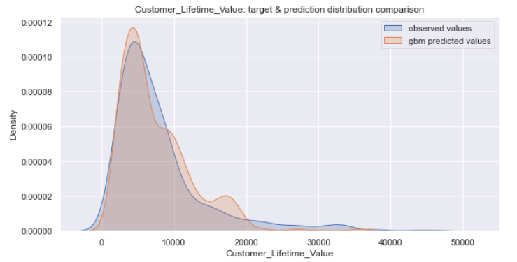
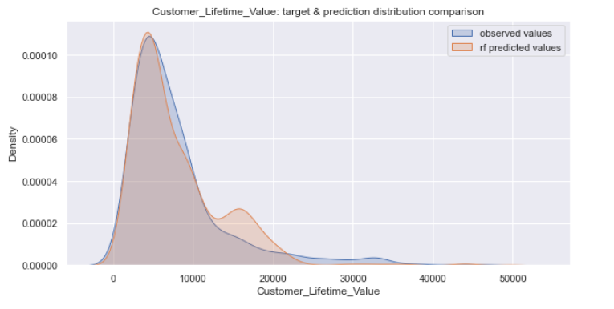
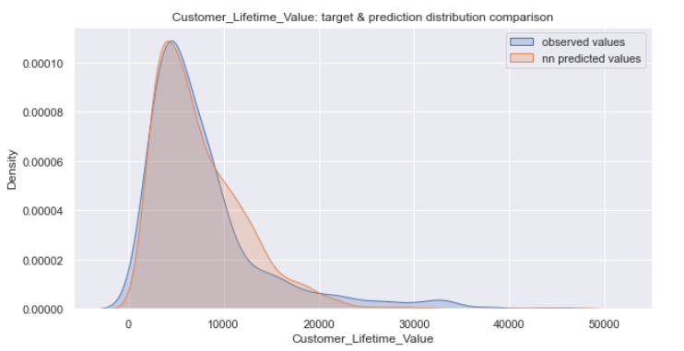
Distribution of predicted CLV by models
GLM
GBM
RF
NN

Slide 17
Unsupervised Learning

Slide 18
Unsupervised Learning
Unsupervised Learning describes tasks that involves using a model to discover a good internal representation of input data useful for subsequent Supervised Learning.
Dimensionality Reduction:
it is the process of reducing the amount of features to a set of principal variables
Clustering: it is the process used to discover inherent groupings in the data
Anomaly detection: it is the process used to discover unusual data points in the data set
Association: it is the process used to discover sets of items that frequently occur together in the data set

Slide 19
Dimensionality Reduction

Slide 20
Principal Component Analysis (PCA)
Principal Components Analysis, by an orthogonal transformation, finds principal components, a sequence of linear combinations of the variables that have maximal variance, and are mutually uncorrelated. This linear transformation fits the data set into new variables (coordinates) where the eigenvectors called loadings represent the directions of the principal axes, whereas the eigenvalues represent the amount of variance that principal components capture from the data when they are projected onto these axes. The principal components are a straight line, and the first principal component holds the most variance. Each following principal component is orthogonal to the last one and has a smaller variance.

Slide 21
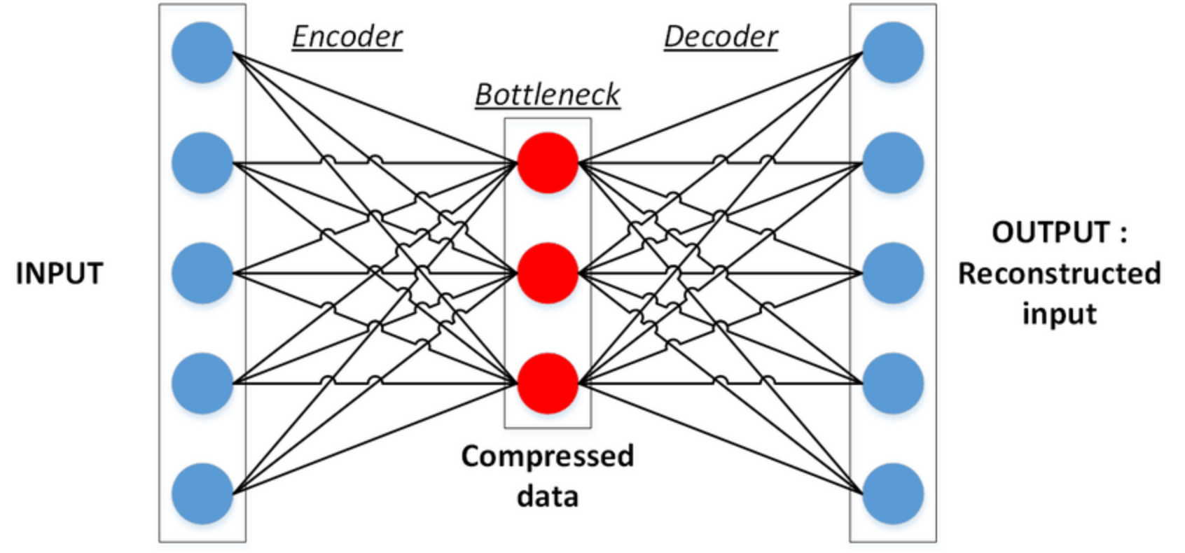
Autoencoders
Autoencoder, like PCA, is a tool to find a lower-dimensional representation of high-dimensional data, but unlike PCA is able to capture non-linearity using activation functions. Autoencoders are Neural Networks where the output layer has the same dimension of the input layer. An autoencoder replicates the data from the input to the output in an unsupervised manner, reconstruct each dimension of the input by passing it through the network. During the replication process, the size of the input is reduced into its smaller representation held in a latent space then the output is reconstructed from this reduced representation of the input. The architecture of an Autoencoder is based on:
-Encoder: it is a feedforward neural network that compresses the input into a latent space representation.
-Bottleneck: the middle layer of the network that contains the reduced representation of the input that is fed into the decoder.
-Decoder: it is also a feedforward neural network like the encoder and rebuild the input back to the original dimensions from the bottleneck.

Slide 22
Isomap
Isomap, a.k.a. isometric mapping, is a non-linear dimensionality reduction method based on the spectral theory which tries to preserve the geodesic distances in the lower dimension. Isomap starts finding nearest neighbours to each sample, and after that, it uses graph distance to estimate the geodesic distance between all pairs of points computing their shortest path distances. At the end, through eigenvalue decomposition of the geodesic distance matrix, it builds the low dimensional embedding of the data set.

Slide 23
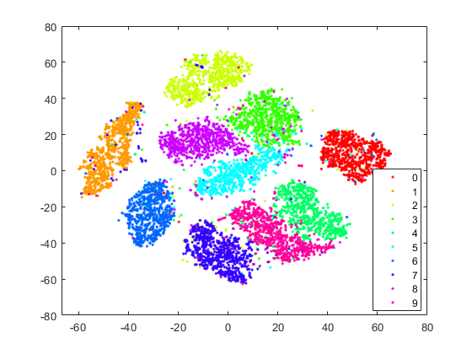
T-Sne
t-Distributed Stochastic Neighbor Embedding (t-SNE) is a non-linear method for dimensionality reduction and it’s used to explore high-dimensional data sets. The algorithm starts by converting the high-dimensional Euclidean distances between data points into conditional probabilities that represent similarities. Then it computes a similar conditional probability for the low-dimensional data points corresponding to the high-dimensional data points. After that it tries to minimize the difference between these conditional probabilities (or similarities) using a gradient descent method. t-SNE try to minimize the divergence between two distributions, it finds patterns in the data discovering clusters based on similarity of data points with multiple features, but it isn’t a clustering.

Slide 24
Dimensionality Reduction Analysis

Slide 25
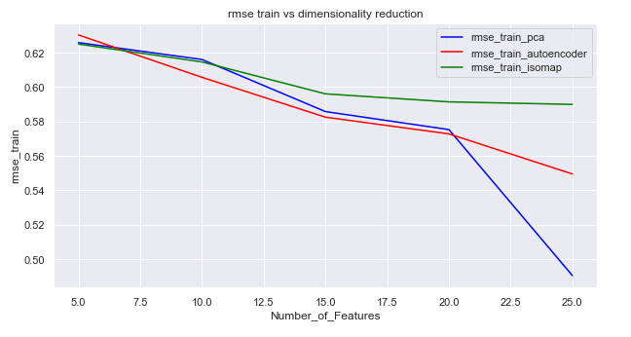
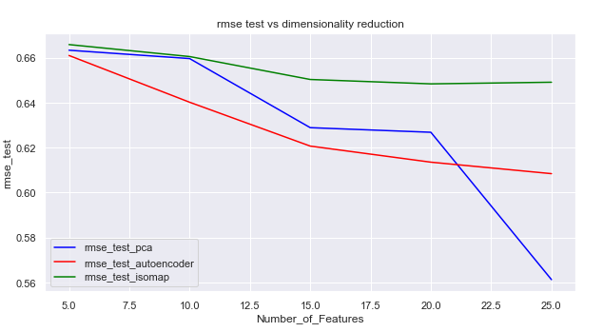
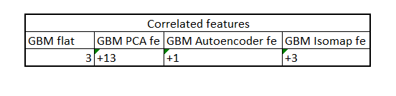
Reconstruction error of dimensionality reduction by GBM
….and by correlation with features from original data set

Slide 26
CLV Prediction with reduced features space

Slide 27
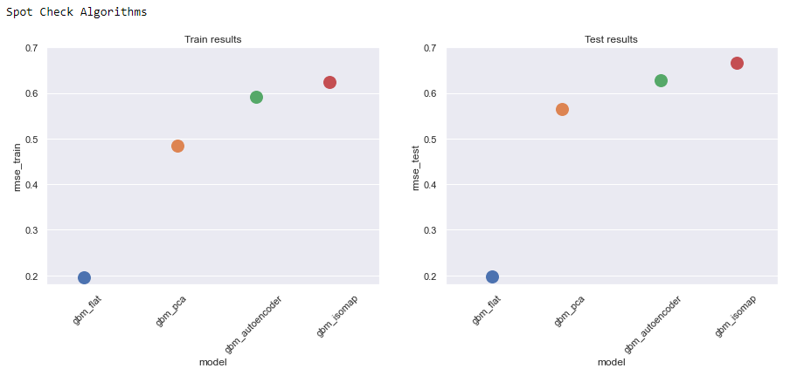
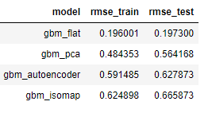
Evaluation of CLV performance using
features from dimensionality reduction

Slide 28
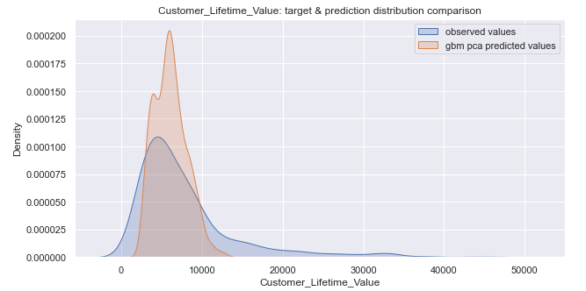
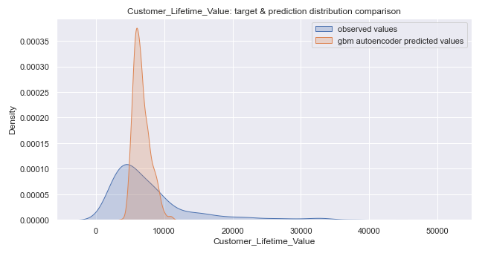
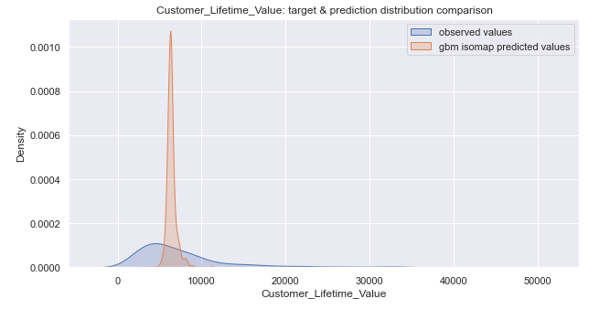
Comparison between baseline model and others gbm models built using
features from dimensionality reduction
Baseline
PCA
Autoencoders
Isomap

Slide 29
CLV Prediction with augmented features space

Slide 30
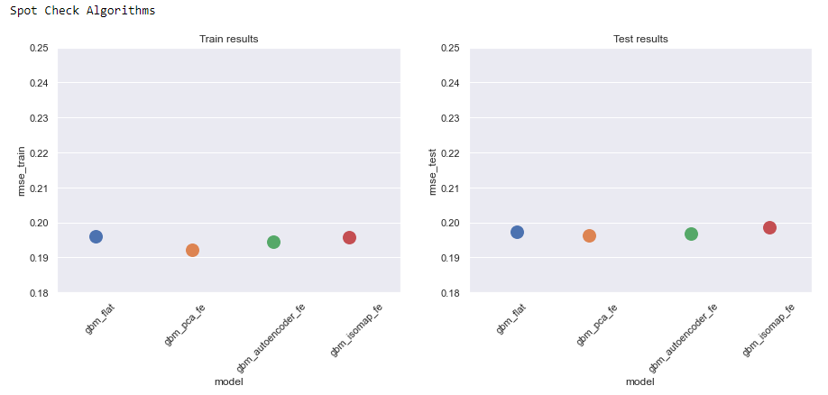
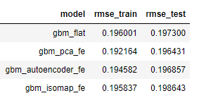
Evaluation of CLV performance adding
features from dimensionality reduction at the baseline model

Slide 31
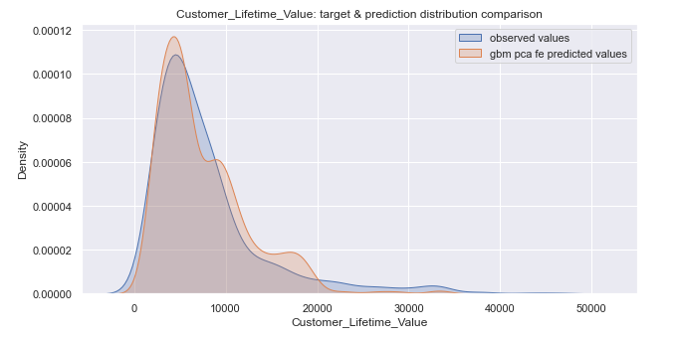
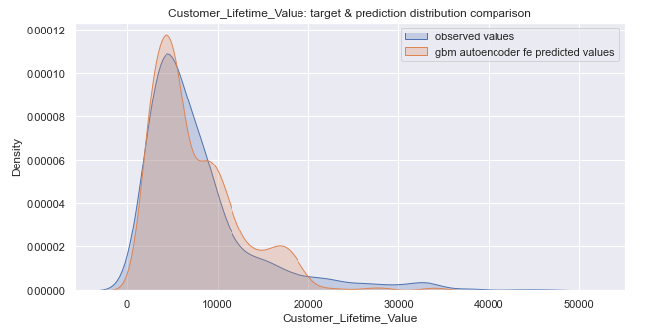
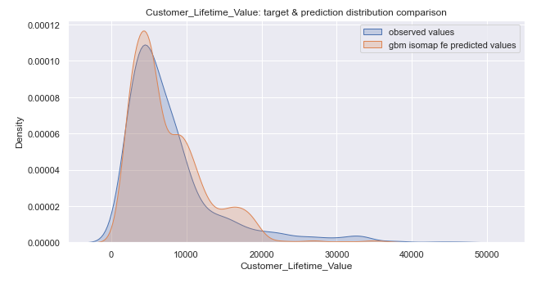
Comparison between baseline model and others gbm models built augmenting the baseline model with features from dimensionality reduction
Baseline
Baseline augmented with pca features
Baseline augmented with autoencoders features
Baseline augmented with isomap features

Slide 32
Clustering

Slide 33
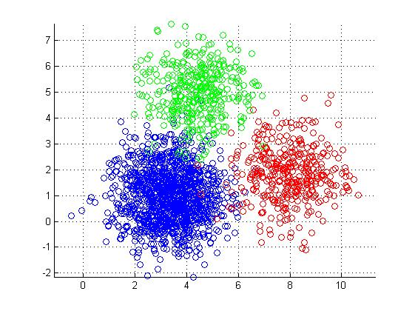
K-Means
K-Means is a centroid-based clustering that try to minimize the distance between each point to the assigned cluster centroid. It starts to pick a number of clusters, k, and for each one calculates the coordinates of its centroid. Points are assigned to the nearest cluster centroid, after that, centroids position are re-computed by the mean of all observations assigned to the cluster. It’s an iterative process until centroids don’t change much between iterations anymore.

Slide 34
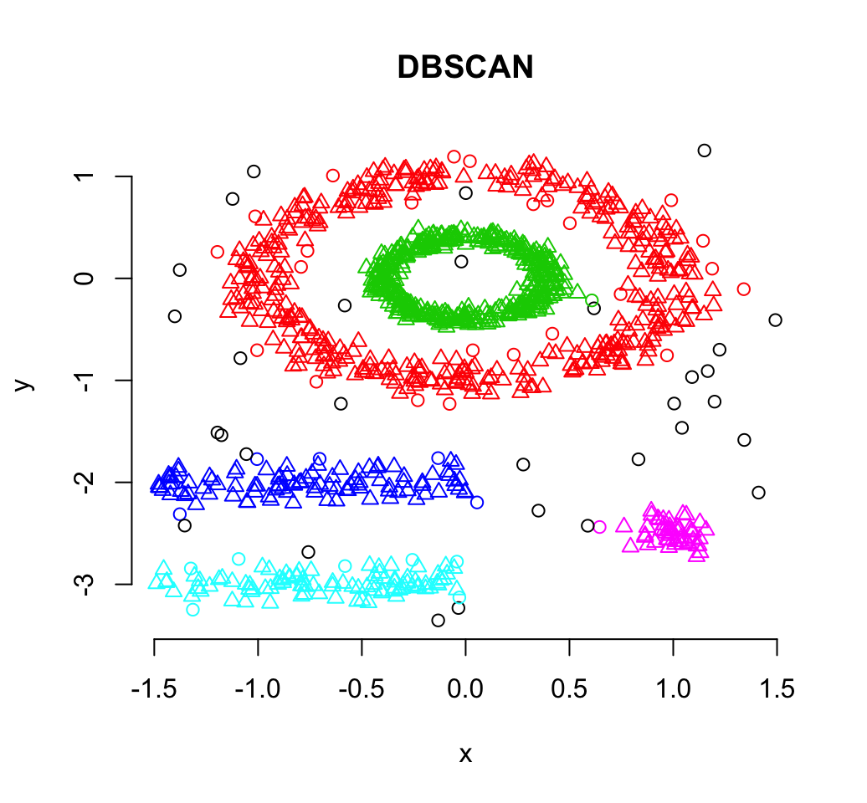
DBSCAN is a density-based clustering algorithm that defines clusters as continuous regions of high density, grouping together points with many nearby neighbours and marking outlier points in low-density regions. It starts picking a point at random and retrieves its neighbourhood. If it is a core point (it has at least min number of points “minPoints” within a distance “ε” used to locate neighbourhood), it will start a new cluster expanded by assigning all points in its neighbourhood to the cluster. If an additional core point is found in the neighbourhood, the search is extended to include all points in its neighbourhood. If no more core points are found, the cluster is complete, and remaining points are examined to look for other core point to start a new cluster. Points not assigned to a cluster are considered noise.
DBSCAN

Slide 35
Gaussian Mixture Models
Gaussian Mixture Models clustering is a generalization of K-Means. Instead of using a distance-based model, will be used a distribution-based model. In K-Means clusters are circular as a result of using the mean as centroid. With GMM will be assumed data points are Gaussian distributed with clusters that can take any kind of elliptical shape and each Gaussian distribution is assigned to a single cluster. The Expectation-Maximization optimization algorithm is used to find the parameters of the Gaussian distribution for each cluster.

Slide 36
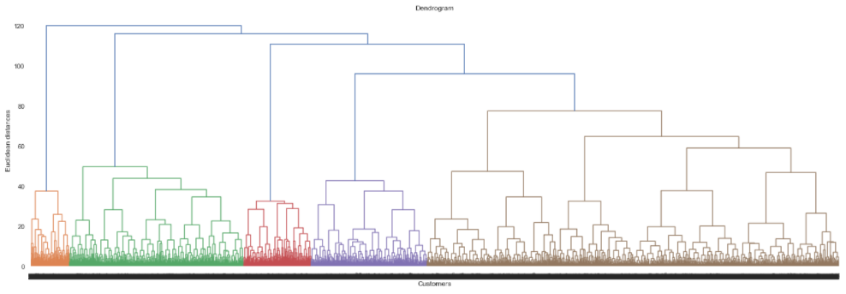
Agglomerative Hierachical Clustering
Agglomerative Hierarchical clustering builds hierarchy of clusters by a bottom-up approach. It starts with all points assigned to a cluster of their own, so given N observations will have N clusters. Find a pair of clusters with the smallest cluster-to-cluster distance. Merge the two clusters into one, reducing the number of clusters to N-1. The process go ahead till all points are merged into one cluster, the root cluster. The result of agglomerative hierarchical clustering can be shown by a dendrogram.

Slide 37
Clustering Analysis

Slide 38
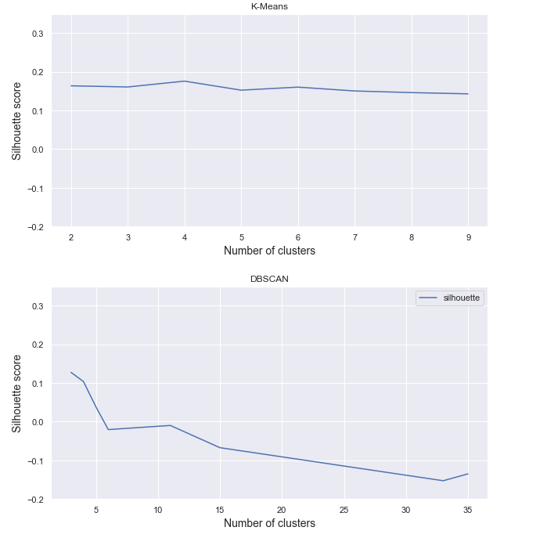
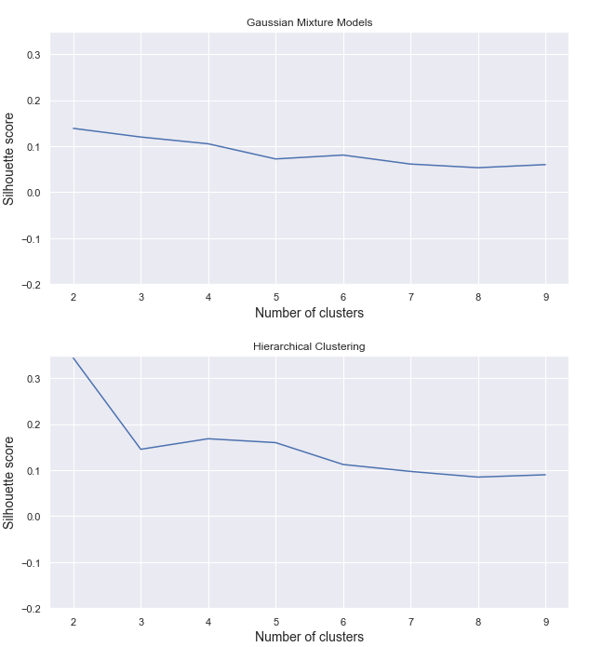
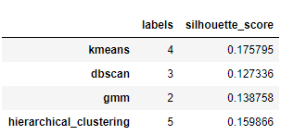
Clustering Analysis
Clustering algorithms evaluated by silhouette score

Slide 39
CLV Prediction with augmented features space

Slide 40
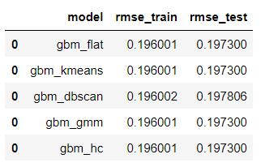
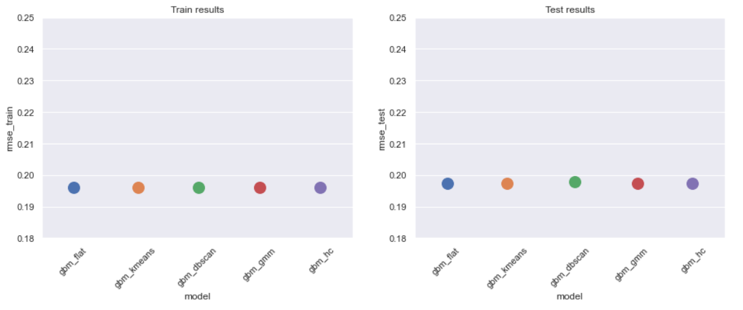
Evaluation of CLV performance adding
features from clustering at the baseline model

Slide 41
Clustering as Portfolio Analysis

Slide 42
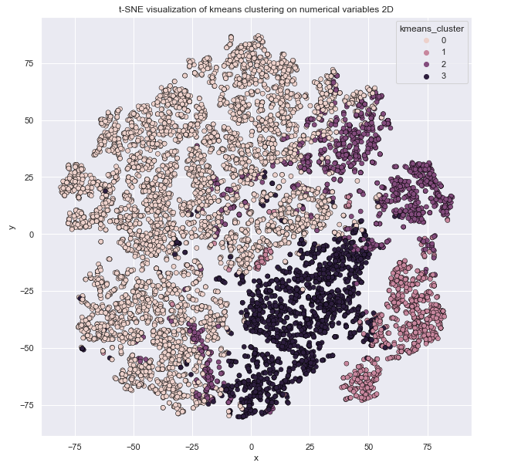
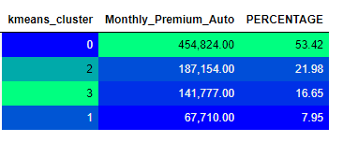
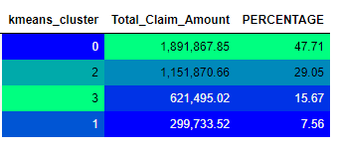

K-Means results

Slide 43





Slide 44




DBSCAN results

Slide 45





Slide 46




GMM results

Slide 47





Slide 48




Agglomearive Hierarchical Clustering results

Slide 49





Slide 50
Conclusions
Opportunity to use features extracted by dimensionality reduction tools as new additional features
Clustering can improve a portfolio and strategy analysis
Some models give good performance but are quite a black-box
References
T. Hastie, R. Tbishirani, J. Friedman, “The Elements of Statistical Learning”, 2017, Springer
M. V. Wutrich, S. Rentzmann, “Unsupervised Learning: What is a sport car?”, 2019, SSRN.
I. Goodfellow, Y. Bengio, A. Courville, “Deep Learning”, 2016, MIT Press
Yoon Hyup Hwang, “Hands-On Data Science for Marketing”, 2019, Packt
G. Bonaccorso, “Hands-On Unsupervised Learning with Python”, 2019, Packt

Slide 51

???
Contacts: c.giancaterino@gmail.com

